Slide 1
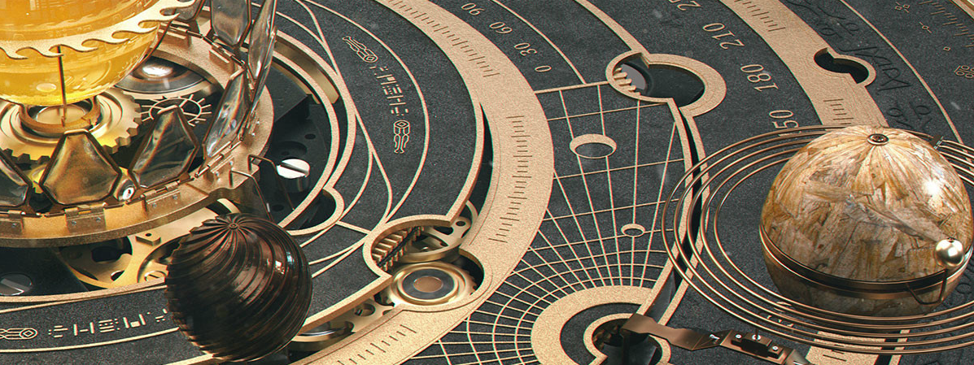


Cosmic Machines
An introduction to Machine Learning for observational astronomy
Lachlan Campbell | 21 August 2019

Slide 2
Introduction
Motivation – My reasons for this workshop and how it came about.
Challenge – can we use machine learning to classify SDSS images to better than 90% accuracy?
Machine Learning basics – Artificial Neural Networks and Deep Learning.
Hands-on – Using fast-ai and Google Colab to solve our challenge.
Depending upon time:
Convolutional Neural Networks – An introduction.
Other challenges?

Slide 3
Learning problems for neural networks
A supervised learning algorithm attempts to model a function to relate inputs to outputs. It uses known examples to learn this relationship. For e.g. we might want a model to distinguish whether an image is of a dog or a cat.
After using images as examples to train (or teach) the model, you’ll want to use images to test the model; that is, to determine if the model is actually successful at identifying if the image is of a dog or a cat.
A trained model should be able to predict an output given a new input which it has never seen before. This is known as generalization.
We need to evaluate how well a model and learning algorithm generalizes the observed data to the unobserved data. One simple way to do this is to split the input data into two sets, one set to train the model on and another to evaluate how well it generalizes. The second set is known as the test data.
Notes:
What type of problems can we use ANNs for? If we want to distinguish between an image of a cat and a dog for eg. A supervised learning algorithm tries to model a function that relates inputs to outputs, so in this case the input would be an image, the output would be a classification of cat or dog.

Slide 4
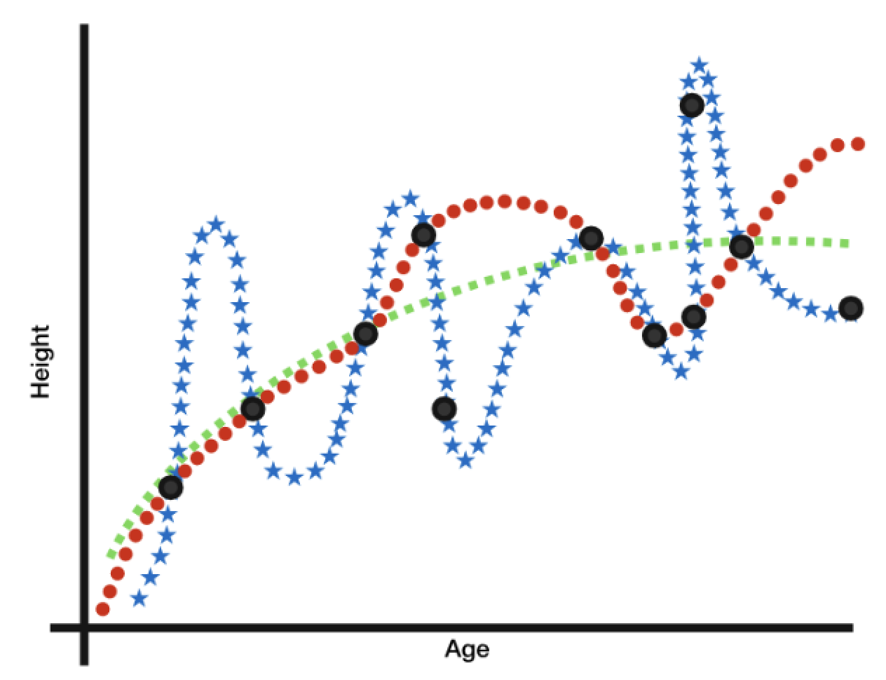
Learning problems for neural networks
For any observed data, there are an infinite number of functions that pass through all input-output pairs. The “best” function is not necessarily one which fits all of the observed data, but instead is one that generalizes well.
You are training a height-prediction model using observed inputs of children’s ages and outputs of their heights, shown as points in the graph above. Which of the three functions drawn is likely to be the best model?
Notes:
Given just the points we would be more likely to draw a curve resembling the green one – especially given our intuition about how age and height should relate to each other. In particular the sharp changes in predicted height for similar age values in the blue and red models do not make sense.

Slide 5
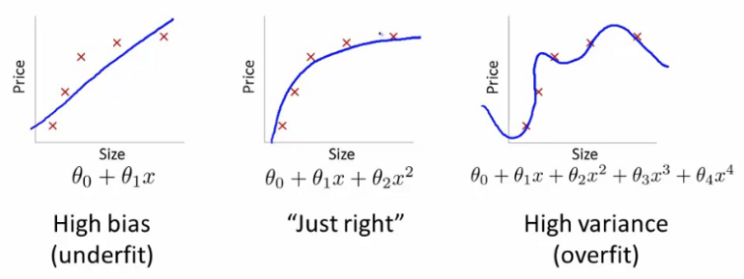
Learning problems for neural networks
Typically, a simple function is more likely to avoid overfitting (making a model needlessly complex) and therefore better generalize.

Slide 6
Learning problems for neural networks
In distinguishing between cats and dogs, we wanted to classify an image into discrete categories with no numerical relationship; i.e. we cannot say dog is 2 times cat. This is called a classification problem.
In the previous question, we found a function to relate an input to a numerical output (height). These outputs have a clear numerical relationship; e.g. the output of 6 feet is twice the output of 3 feet. This type of problem is known as a regression problem.
Artificial neural networks (ANNs) are flexible enough to be used in both classification and regression problems.

Slide 7
Learning problems for neural networks
Many of the basic applications of ANNs involve supervised learning. However, there is another type of learning: unsupervised learning.
Unsupervised learning attempts to determine relationships between inputs without using any example outputs.
We now have a big-picture sense of what learning problems are all about. There are two main types of learning: unsupervised and supervised, and problems within supervised learning can be categorized as classification or regression problems. We will be focusing on ANNs, a computational model that performs well in a wide variety of learning problems such as the ones discussed.
Next we’ll explore the basics of how the human brain works and how these ideas inspire the mechanisms within ANNs.

Slide 8
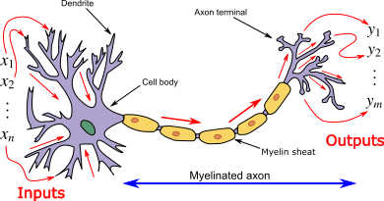
Computationally modelling the brain
Neurons are the simplest units of computation in the human brain, and their interactions facilitate learning.
Neurons each compute a simple function. While the actual dynamics of a neuron’s computation are complex, a simplified view of them is that they integrate and fire.
i.e. a neuron performs a computation with its inputs, and then fires if that computation passes a certain threshold.

Slide 9
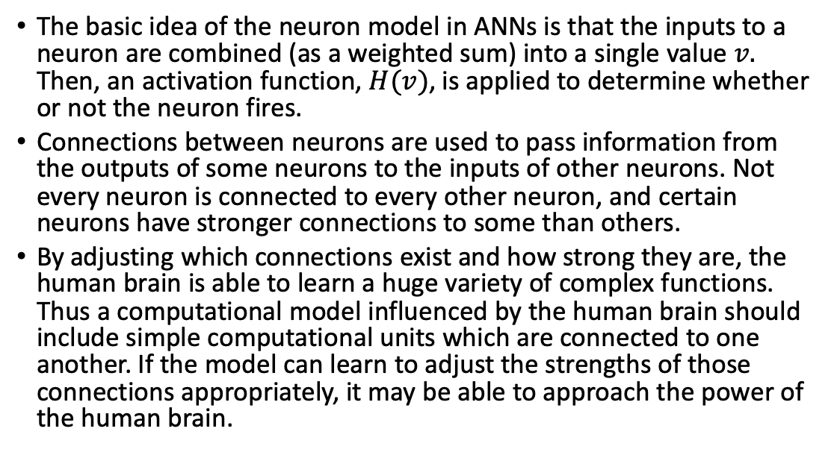
Computationally modelling the brain
The basic idea of the neuron model in ANNs is that the inputs to a neuron are combined (as a weighted sum) into a single value $v.$ Then, an activation function, $H(v)$, is applied to determine whether or not the neuron fires.
Connections between neurons are used to pass information from the outputs of some neurons to the inputs of other neurons. Not every neuron is connected to every other neuron, and certain neurons have stronger connections to some than others.
By adjusting which connections exist and how strong they are, the human brain is able to learn a huge variety of complex functions. Thus a computational model influenced by the human brain should include simple computational units which are connected to one another. If the model can learn to adjust the strengths of those connections appropriately, it may be able to approach the power of the human brain.

Slide 10
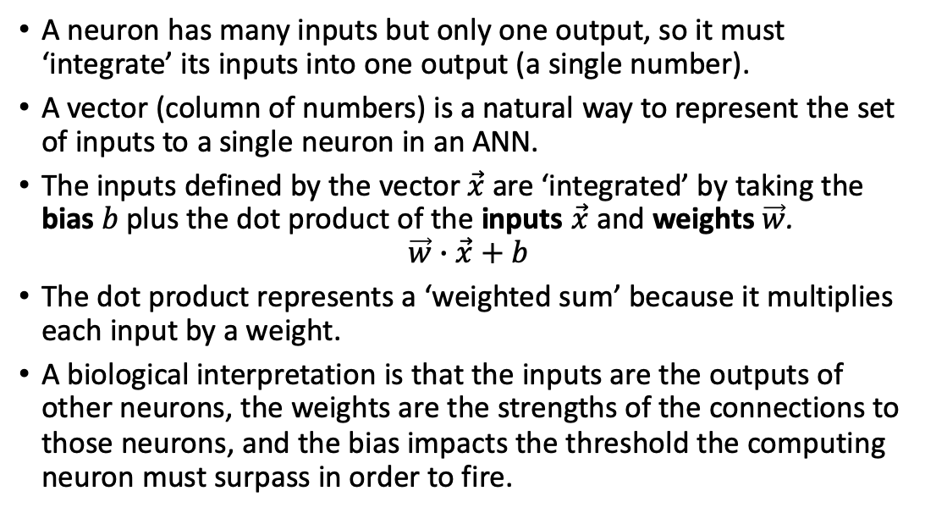
Computational models of the neuron
A neuron has many inputs but only one output, so it must ‘integrate’ its inputs into one output (a single number).
A vector (column of numbers) is a natural way to represent the set of inputs to a single neuron in an ANN.
The inputs defined by the vector $\vec{x}$ are ‘integrated’ by taking the bias $b$ plus the dot product of the inputs $\vec{x}$ and weights $\vec{w}$.
$$\vec{w}∙\vec{x}+b$$
The dot product represents a ‘weighted sum’ because it multiplies each input by a weight.
A biological interpretation is that the inputs are the outputs of other neurons, the weights are the strengths of the connections to those neurons, and the bias impacts the threshold the computing neuron must surpass in order to fire.

Slide 11
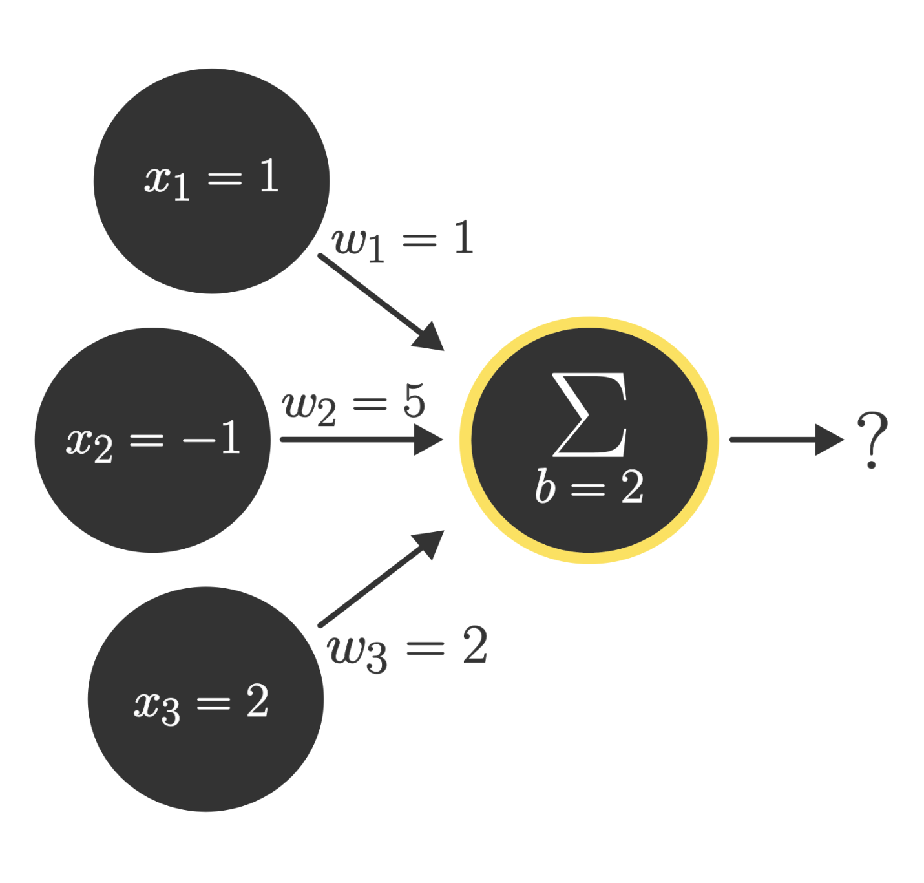
Computational models of the neuron
Notes:
Given the inputs, weights, and bias shown above, what is the integration of these inputs, given by the weighted sum $\vec{w}∙\vec{x}+b$?
Solution: 2

Slide 12

Computational models of the neuron
Physical neurons have an activation function with binary outputs - fire or don’t fire. However ANNs don’t need to be restricted to binary functions. Popular activation functions like the ones below avoid counterintuitive jumps and can model continuous values (e.g. a probability).
Notes:
Non-linear activation functions where one of the key changes that made ANNs work effectively.

Slide 13
Computational models of the neuron
The power of ANNs is illustrated by the universal approximation theorem, which states that ANNs using activation functions like those shown can model any continuous function, given some general requirements about the size and layout of the ANN.
We’ve now built up a basic computational model of neurons. While one neuron might not seem powerful, connecting many together in a clever manner can yield a highly effective learning model.

Slide 14
What is Deep Learning?
A subfield of Machine Learning (ML).
Recognised for its ability to solve complex tasks, like image or language understanding.
Found in our everyday lives, e.g. in voice recognition, computer vision, recommender systems, reinforcement learning and many more.
A new take on learning representations from data which puts an emphasis on learning successive “layers” of increasingly meaningful representations.

Slide 15
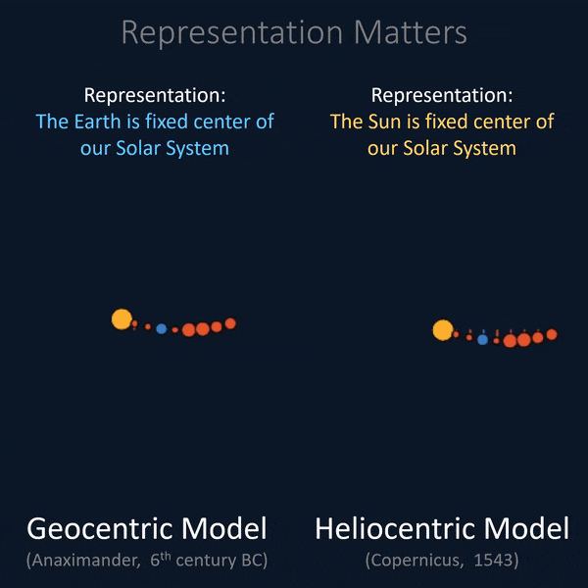
What is Deep Learning?
How we represent the world can make the complex appear simple both to us humans and to the machine learning models we build.

Slide 16
What is Deep Learning?
Deep learning allows computational models that are composed of multiple processing layers to learn representations of data with multiple levels of abstraction. ANNs are just such a model.
ANNs, a network of artificial neurons, consist of the following components:
An input layer
An arbitrary amount of hidden layers
An output layer
A set of weights and biases between each layer
A choice of activation function for each hidden layer
A loss function

Slide 17

What is Deep Learning?

Slide 18
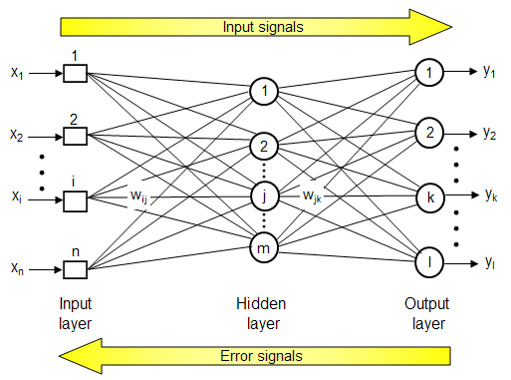
How do ANNs learn?
In order to train an ANN, the following steps are typical:
Calculating the predicted output, known as feedforward.
Evaluating the loss function.
Updating the weights and biases, known as backpropagation.

Slide 19
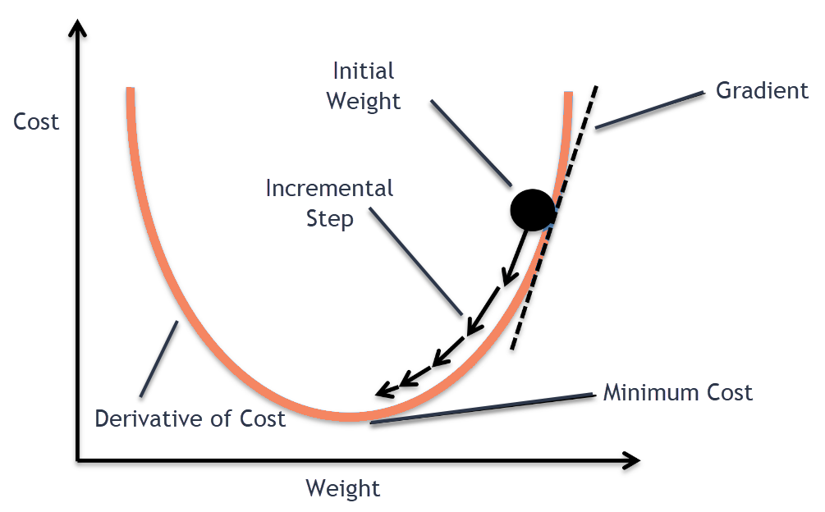
How do ANNs learn?
A commonly used method for minimizing the loss function in ANNs is an iterative approach called gradient descent.

